Slide 1
JSP Expression Language (EL)

Slide 2
JSP Implicit Objects
The main purpose of EL is to simplify the process of accessing data from bean properties and from implicit objects.
It is the newly added feature in JSP technology version 2.0.
There are many implicit objects and operators in EL.
Operators in EL include:
Arithmetic Operators : +, -, *, /, % ,^
Relational Operators: >, <, >=
Logical Operators. (4+2>7) AND (2<5)

Slide 3
Syntax of EL:
${expression}.
whatever present inside braces gets evaluated at runtime and being sent to the output stream.
${…} is the syntax used in JSP documents to mark the contained string as an EL expression.
EL literals:
true, false
decimal integer, floating point, scientific-notation numeric literals
strings (single- or double-quoted)
null

Slide 4
Syntax of EL:
EL variable names: like Java
Can contain letters, digits, _ , and $: x, x1, stu_name (true)
Must not begin with a digit : 1x (wrong)
Must not be reserved. : AND, OR, gt (wrong)
EL operators:
Relational: <, >, <=, >=, ==, !=
Or equivalents: lt, gt, le, ge, eq, ne
Logical: &&, ||, !
Or equivalents: and, or, not
Arithmetic:
+, - (binary and unary), *
/, % (or div, mod)
empty: true if arg is null or empty string/array/Map/Collection
Conditional: ? :
Array access: [ ] (or object notation)
Parentheses for grouping. ()

Slide 5
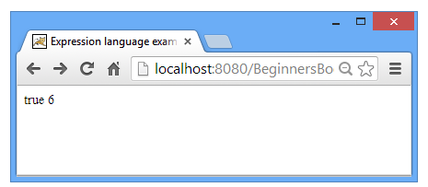
Example 1: Expression language evaluates the expressions
<html>
<body>
${1<2}
${1+2+3}
</body>
</html>

Slide 6
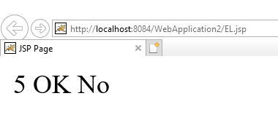
Example 2: IF statement in Expression language
<html>
<body>
${x = 5}
${x==5 ? “Ok” : “No”}
${x ne 5 ? “Ok” : “No”}
</body>
</html>

Slide 7
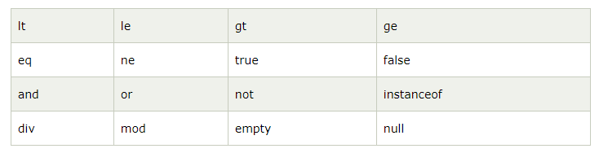
Reserve Words in Expression language

Slide 8
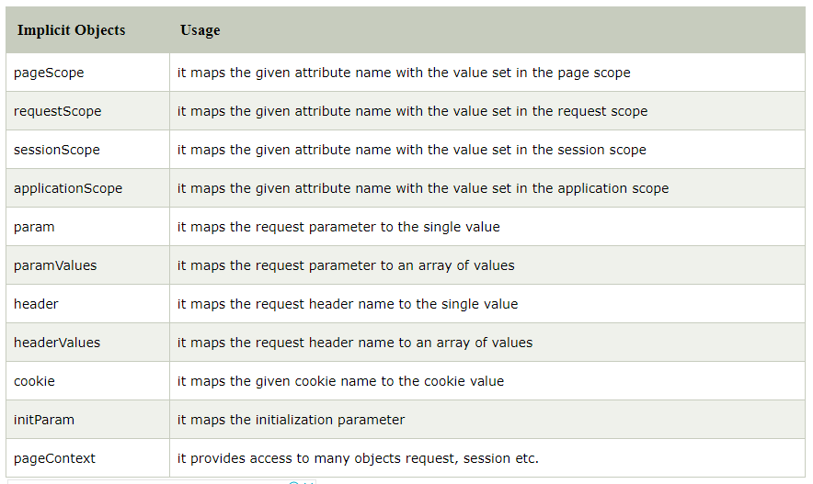
EL implicit objects:
Similar to implicit objects in JSP, there are predefined variables in EL.

Slide 9
1- EL implicit object: param
Example 3:
In this example we are prompting user to enter name and roll number. On the other JSP page we are fetching the entered details using param variable of EL.
index.html
display.jsp
<html>
<body>
<form action=“display.jsp“ >
Student Name: <input type ="text" name=“stuname“ ><br>
Student RollNum: <input type ="text" name=“rollno“ ><br>
<input type ="submit" value=“Submit"> <br>
</form>
</body>
</html>
<html>
<body>
Student Name is: ${ param.stuname }
Student Roll No is ${ param.rollno }
</body>
</html>

Slide 10
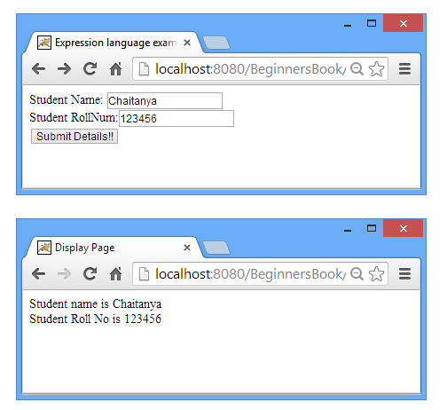

Slide 11
2- EL implicit object: sessionScope
Example 4:
In this example, we printing the data stored in the session scope using EL. For this purpose, we have used sessionScope object.
index.html
display.jsp
<html>
<body>
<h3>welcome to index page</h3>
<%
session.setAttribute("user",“ahmed");
%>
<a href=“display.jsp">visit</a>
<html>
<body>
<html>
<body>
Value is ${ sessionScope.user }
</body>
</html>

Slide 12
3- EL implicit object: cookie
Example 5:
In this example, we printing the data stored in the cookie using EL. For this purpose, we have used cookie object.
index.html
display.jsp
<html>
<body>
<%
Cookie ck=new Cookie("name",“ali");
response.addCookie(ck);
%>
<a href=“display.jsp">click</a>
<html>
<body>
<html>
<body>
Hello, ${cookie.name.value}
</body>
</html>

Slide 13
4- EL implicit object: applicationScope
Example 6:
In this example we have set the attributes using application implicit object and on the display page we have got those attributes using applicationScope of Expression language.
index.html
display.jsp
<html>
<body>
<%
Application.setAttribute(“author”,”Ziad”);
Application.setAttribute(“site”,”google.com”);
%>
<a href=“display.jsp">click</a>
<html>
<body>
<html>
<body>
Hello, ${applicationScope.author}<br>
Site, ${applicationScope.site}
</body>
</html>

Slide 14
5- EL implicit object: pageContext
This EL implicit object allows to access all other JSP implicit objects and their properties.
${pageContext.session.id}
${pageContext.request.remoteAddr}
${pageContext.request.protocol}
${pageContext.request.serverName}
${pageContext.request.contentType}

Slide 15
6- EL implicit object: requestScope
Request.getParameter(name)

Slide 16
7- EL implicit object: header
${header["host"]}
Output: localhost:8084
${header["accept"]}
Output: text/html, application/xhtml+xml, image/jxr, */*
${header[“user-agent"]}
Output: Mozilla/5.0 (Windows NT 10.0; WOW64; Trident/7.0; rv:11.0) like Gecko

Slide 17
EL implicit object
pageContext: provides access to JSP implicit objects.
Ex: EL expression pageContext.request is reference to the JSP request object
page: JSP implicit object representing the servlet itself.
JSP objects page, request, session, and application all have getAttribute() and setAttribute() methods
These objects store EL scoped variables

